Slide 1
BLUE BIKES AND PUBLIC TRANSIT
Michael Brady, Daniel Heo, Justin Wells
Notes:
Mikey

Slide 2
TABLE OF CONTENTS
01
02
03
04
05
INTRODUCTION
MOTIVATION
DATA SUMMARY
ANALYSIS
CONCLUSION
Notes:
Mikey

Slide 3
01
INTRODUCTION

Slide 4
What are Blue Bikes?
Blue Bike Stations: Blue Bikes is Boston's public bike-sharing system, where users can rent bicycles for short-term use
Locations and Accessibility: Stations are placed across Boston and surrounding areas to connect residents to key destinations, public transit, and recreational routes
Membership Options: Blue Bikes offers flexible access plans, allowing users to choose between becoming members for unlimited rides or casual riders for paying per ride, catering to both frequent and occasional users
Notes:
Justin

Slide 5
Research Goal
Describe Blue Bike usage patterns in Boston and understand how Blue Bikes interact with MBTA infrastructure
Why It Matters
Enhance multimodal transportation planning
Improve urban mobility and sustainability
Notes:
Daniel

Slide 6
Research Steps
EDA and GIS:
ML Models:
What MBTA lines are most popular with Blue Bike stations? (Heatmap Analysis)
How does activity at Blue Bike stations near MBTA stops differ from those far away?
How do member and casual usage differ?
Are the people who use Blue Bikes for first/last mile public transit commutes primarily blue bike members?
What features define the clusters of the most/least popular blue bike stations?
Notes:
Mikey

Slide 7
Objectives
Understand
Identify
Examine
Blue Bike usage across Boston
Popular stations, member vs. casual, electric vs. classic, temporal trends
Where Blue Bikes and MBTA interact the most
Whether Blue Bike usage aligns with MBTA travel peak times
Factors contributing the most to the more popular Blue Bike stations
Prevalence of Blue Bikes as first/last-mile solutions for MBTA members
Notes:
Justin

Slide 8
02
MOTIVATION
Notes:
Mikey

Slide 9
– Michelle Wu, Boston Mayor
“Our publicly owned bike share system is essential to Boston’s transportation system. It is a reliable, low-cost option – and fun, too!”
Notes:
Mikey

Slide 10
Motivation for Research
Current Blue Bike and MBTA Integration:
Over 70% of MBTA transit stations are co-located with Blue Bike stations
Blue Bikes actively included in plans to mitigate public transit disruptions with MBTA
Recent Expansion Plans:
In September 24, 2024, the City of Boston announced plans to build 100 new Blue Bike stations across every neighborhood in Boston expanding the system by 40%
Urban Mobility Goals:
Address first/last-mile transit challenges
Promote environmental benefits:
Reduce reliance on cars
Decrease greenhouse gas emissions
Alleviate traffic congestion
Notes:
Mikey

Slide 11
03
DATA SUMMARY

Slide 12
Adequacy of Dataset
Data Source
Data Cleaning
Blue Bikes Trip Data (September 2024)
Why September 2024?:
Over 480,000 trips recorded
Representative of peak usage (not affected by cold weather, work/school in session)
Recent data provides insight into the current system
Created a 150-meter buffer around MBTA stops in ArcGIS Pro to classify Blue Bike stations as ‘close’ or ‘far’
Joined Blue Bike trip data with MBTA stop data:
Associated MBTA stop and line for each Blue Bike station
Number of docks at each station
Dropped rows with missing start/end station locations
Dropped Blue Bike stations over 5 miles away from MBTA stops
Notes:
Daniel

Slide 13


Dataset Overview
Blue Bikes
MBTA Stops
Variables:
Bike Type, Trip Start Time, Trip End Time, Start Station, End Station, Member or Casual
Variables:
FID, Station, Line, Terminus, Route, Point_X, Point_Y
Notes:
Daniel

Slide 14
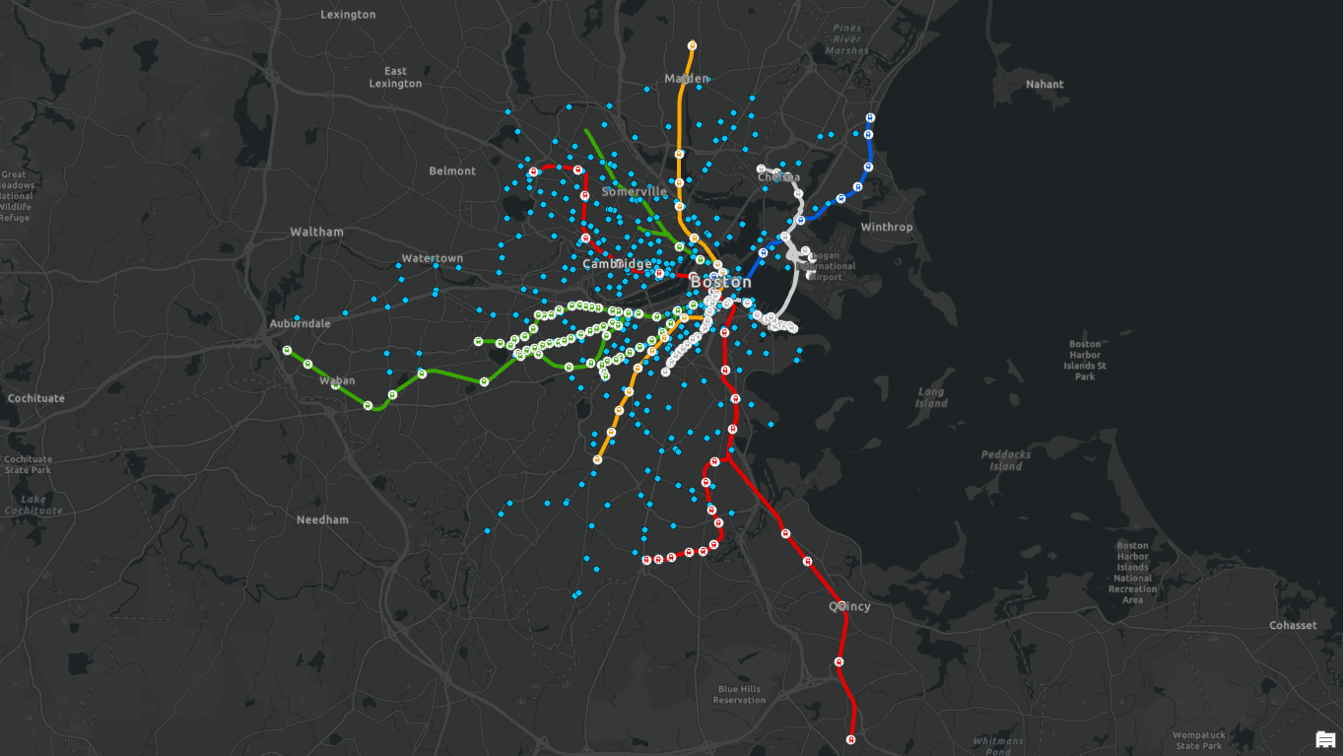
Notes:
Daniel

Slide 15
04
ANALYSIS

Slide 16
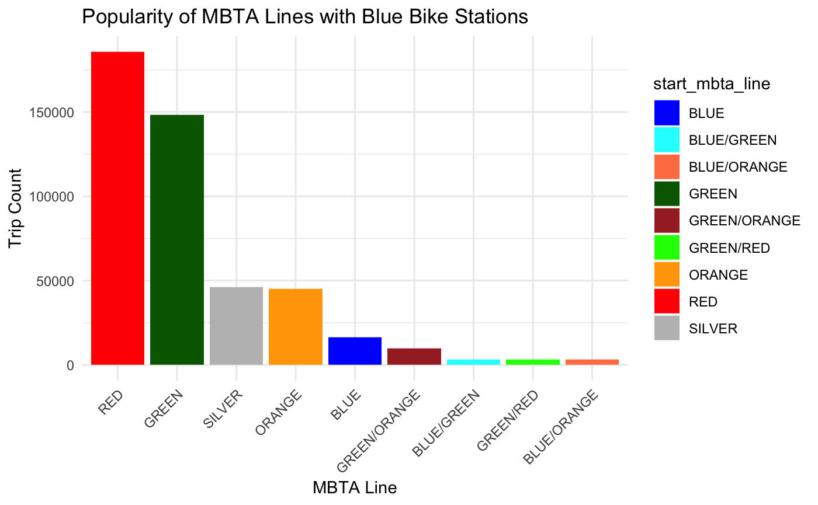
Question 1
What MBTA lines are most popular with Blue Bike stations?
Red and Green lines located mostly in downtown Boston
Logical to assume high trip counts
Green line has mostly above ground stops
Easy access to blue bike stations
Silver, Orange, Blue lines are less popular in the city
Notes:
Justin

Slide 17
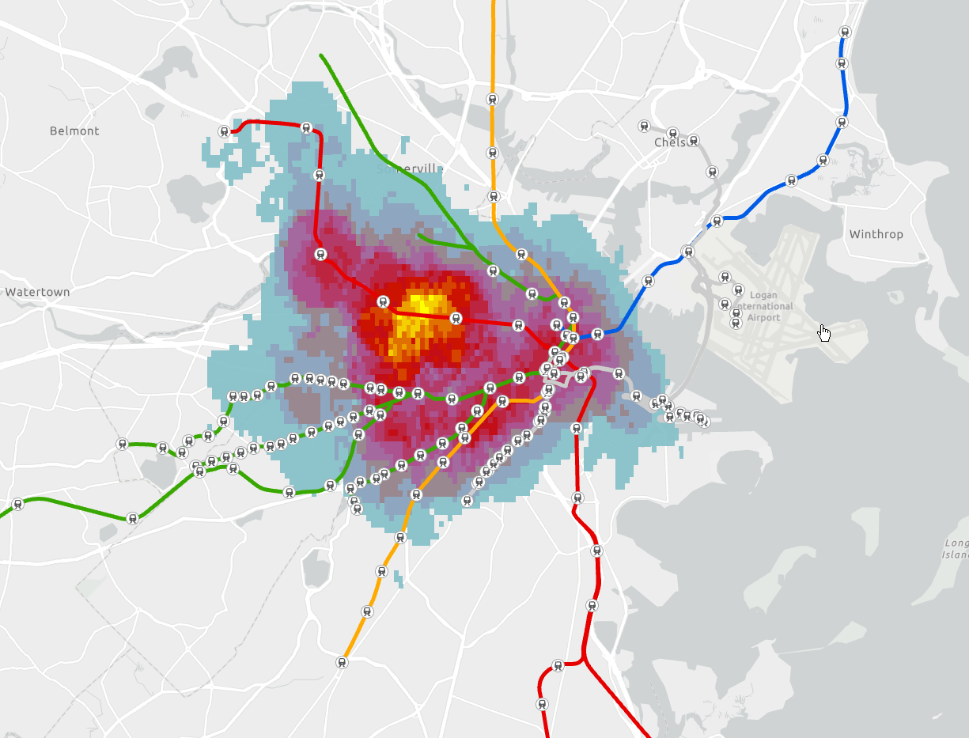
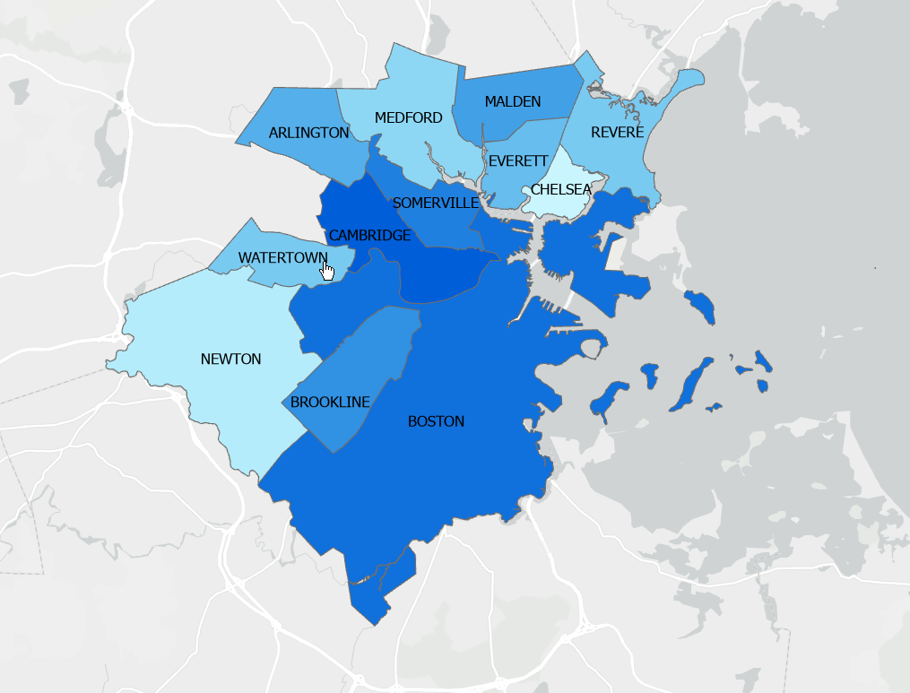
Spatial Analysis in ArcGIS
The highest density of trips that start near MBTA stops are on the Red and Green Lines, more specifically, in areas around downtown Boston
Boston’s central districts and surrounding neighborhoods dominate total trip density, while suburban areas exhibit lower trip density
Notes:
Justin

Slide 18
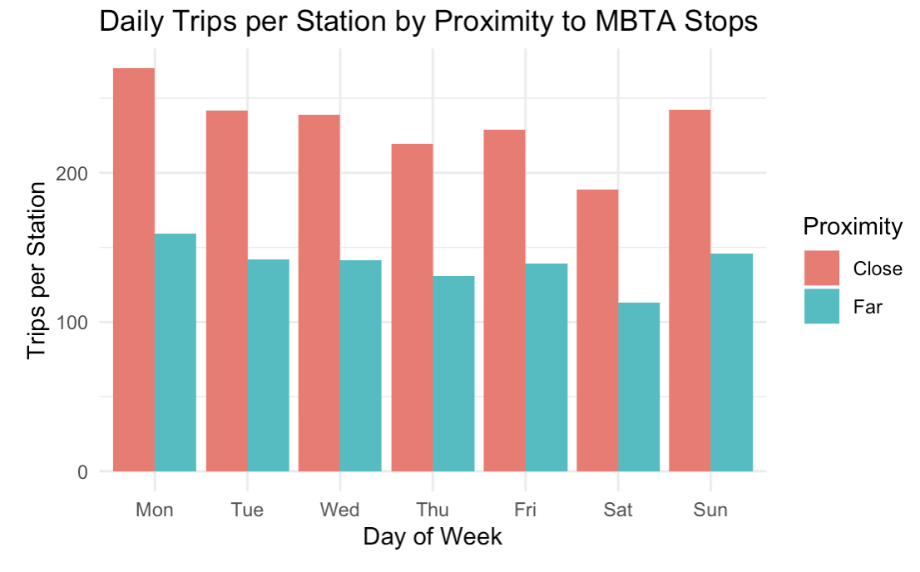
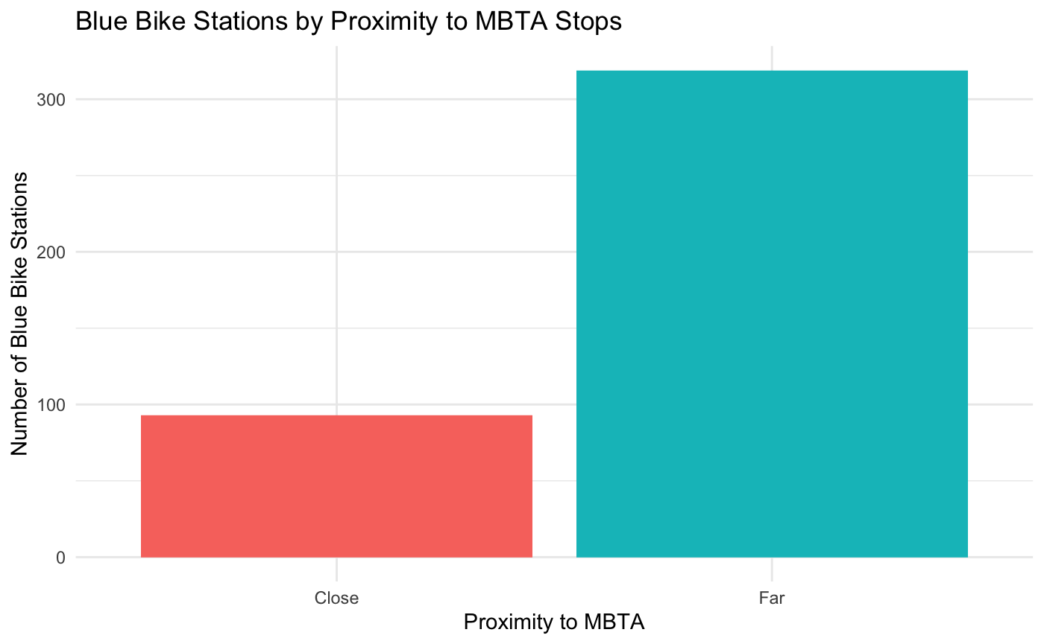
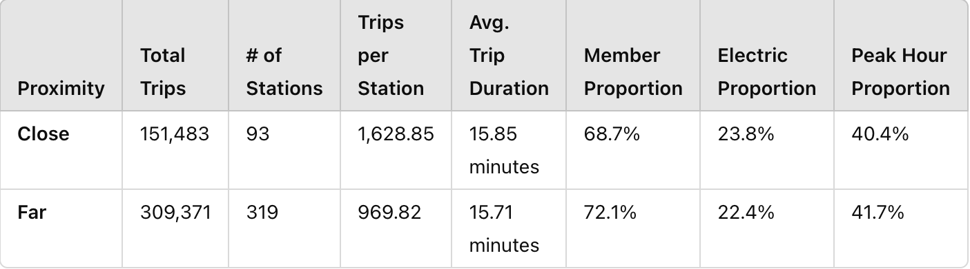
Question 2
How does activity at Blue Bike stations near MBTA stops differ from those far away?
Interpretation:
More ‘far’ stations which makes sense because ‘close’ stations were classified as within 150 meters
Average duration is the same
Close stations exhibit significantly higher trips per station suggesting they serve as major hubs for activity
Member proportion is indicative of overall dataset
~70% member riders
~30% casual riders
Notes:
Justin

Slide 19
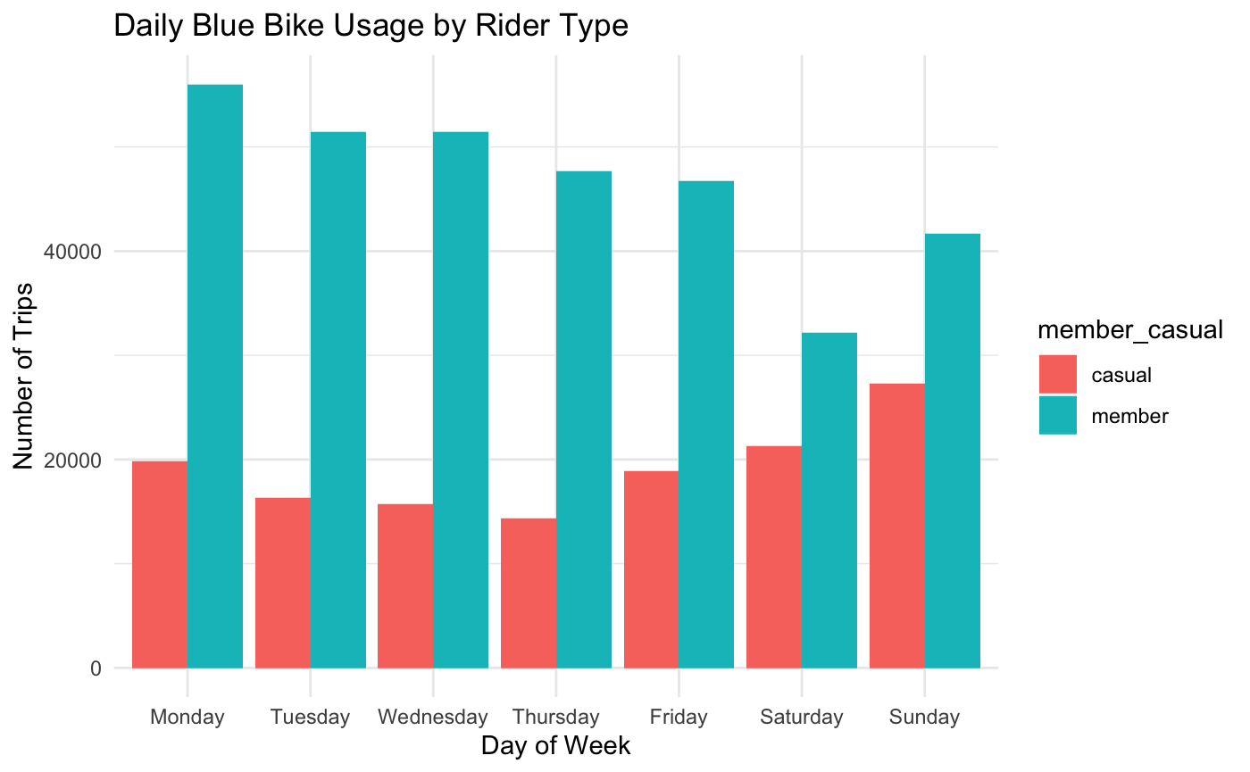
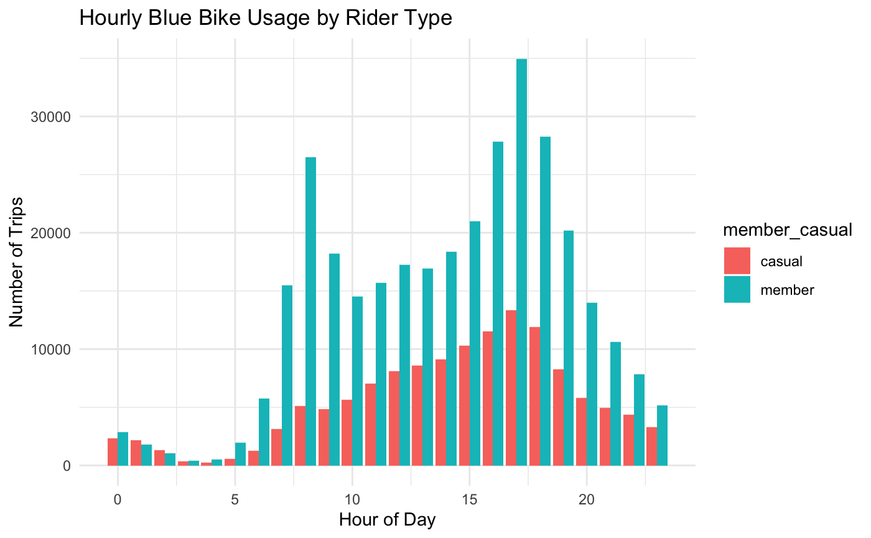
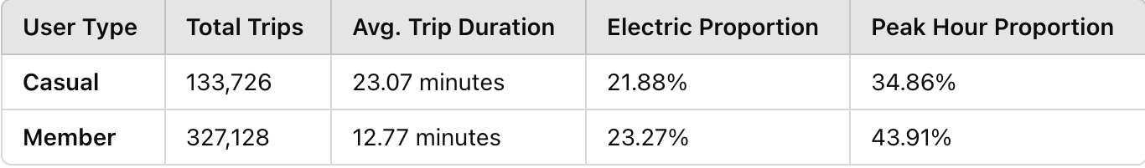
Question 3
How do member and casual usage differ?
Interpretation:
Members take twice as more trips in September as casual
Casual riders take significantly longer trips indicating recreational/exploratory use
Members ride more frequently during peak hours due to work/routine related trips (7-9am and 5-7pm)
Casual riders do not see same peak in morning as members
12am 5am 10am 3pm 8pm
Notes:
Daniel

Slide 20
Question 4
Are the people who use Blue Bikes for first/last mile public transit commutes primarily blue bike members?
Method: Run two logistic regressions to identify potential differences between morning and evening commute activity.
For morning regression: dependent variable equals 1 if a trip ends at a ‘close’ station between 8am and 9am on a weekday
For evening regression: dependent variable equals 1 if a trip starts at a ‘close’ station between 5pm and 6pm on a weekday
Independent Variables included:
Binary variable: 1 if member rider, 0 if casual rider
Binary variable: 1 if electric bike, 0 if classic bike
Trip duration
Notes:
Mikey

Slide 21
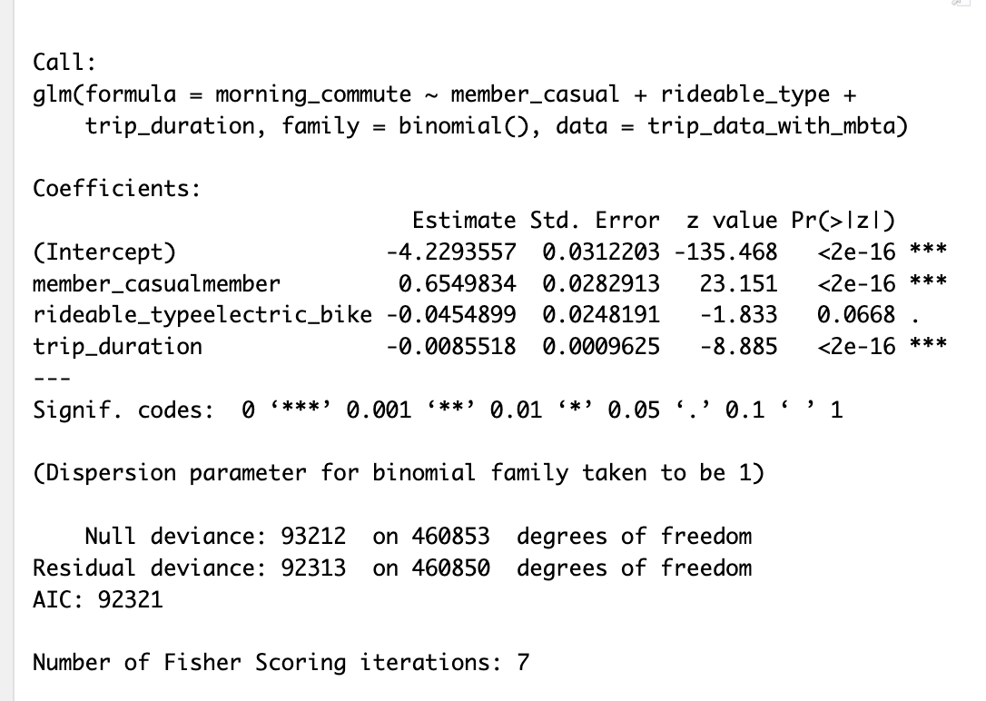
Question 4 - Morning Regression
Are the people who use Blue Bikes for first/last mile public transit commutes primarily blue bike members?
Interpretation:
Members are 93% more likely than casual users to end their trips at a close station during morning commute.
Electric bike users are less likely to end trips at a close station but this is not statistically significant at the 5% level.
For each additional minute of trip duration, the odds of a trip ending at a close station decrease by 0.9% → first mile morning commute not usually very long
Model accuracy: 97.92%
Notes:
Mikey

Slide 22
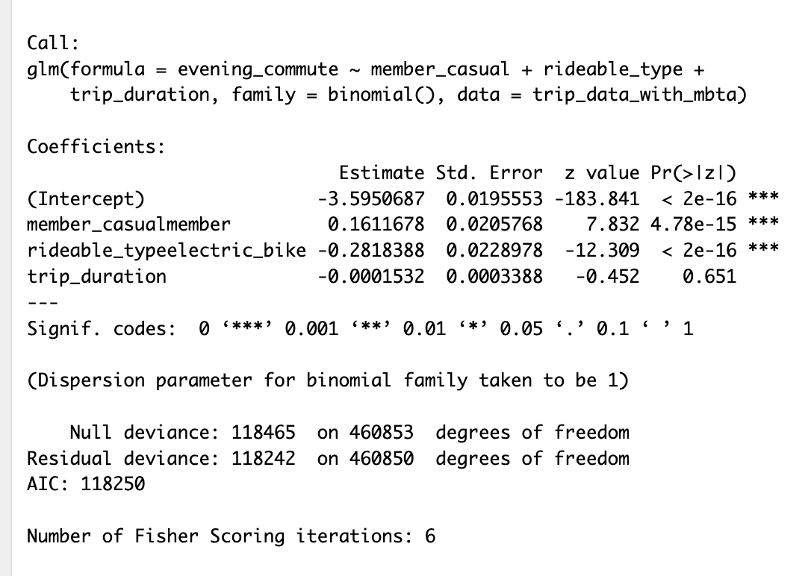
Question 4 - Evening Regression
Are the people who use Blue Bikes for first/last mile public transit commutes primarily blue bike members?
Interpretation:
Members are 66% more likely than casual users to start trips at close stations during evening commute
Electric bike users are 8% less likely to start trips at a close station in the evening → most of these member commuters not using electric bikes
Each additional minute of trip duration decreases odds of a trip starting at a close station by 0.6% → evening commute not excessively long either
Model accuracy: 97.18%
Notes:
Mikey

Slide 23
Question 4 - Model Comparison and Analysis
Are the people who use Blue Bikes for first/last mile public transit commutes primarily blue bike members?
Conclusions:
Yes, Blue Bike members are primarily the ones using Blue Bikes to travel to and from MBTA stops during peak commute times
These members are primarily riding classic bikes
These first/last mile trips are shorter than the average Bike Trip
 | Morning (Odds Ratio) | Evening (Odds Ratio)
Member or Casual Rider | 1.93 | 1.66
Electric or Classic Bike | 0.96 | 0.92
Trip Duration | 0.99 | 0.99
Notes:
Mikey - by extension, we believe that the blue bike system is able to have such a large membership because of its ability to serve as a first/last mile commute option.

Slide 24
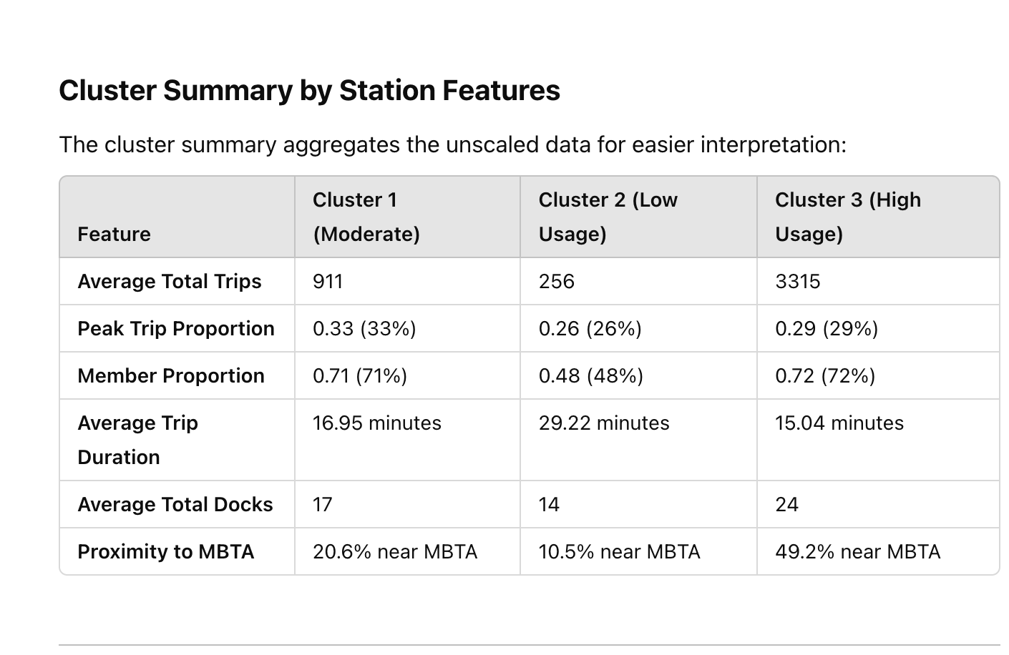
Question 5
What features define the clusters of the most/least popular blue bike stations?
Method: K-means Clustering Analysis
Parameters:
Total trips
Peak-hour trip proportion
Member-casual proportion
Average trip duration
Number of docks
Proportion of Stations ‘close’ to MBTA stops
Cluster 1: Moderate Usage → consistent usage mainly driven by members. Moderate dock availability probably suitable for demand
Cluster 2: Low Usage → underutilized stations likely located in areas far from public transportation. Used more by casual riders for longer rides, and have fewer docks to match lower demand.
Cluster 3: High Usage → busy stations in high-demand areas likely serving as key first/last mile commute hubs. High member proportion and short trip durations align with commuter-heavy usage. More docks to meet high demand.
Notes:
Mikey - unsupervised learning so k-means clustering helps uncover patterns in the data without predefining the group structure

Slide 25
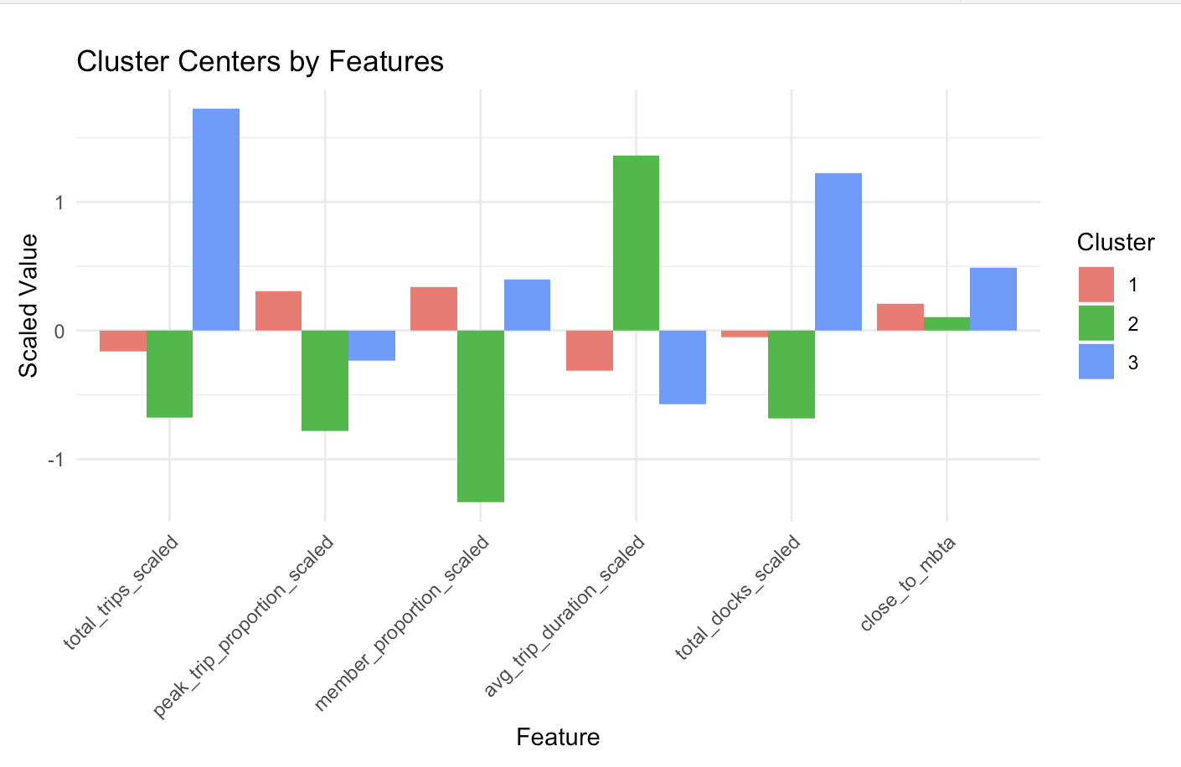
5. What features define the clusters of the most/least popular blue bike stations?
Moderate Usage
Low Usage
High Usage
Total Trips Scaled
Proportion of Trips During Peak Times Scaled
Proportion of member riders scaled
Average trip duration scaled
Total Blocks Scaled
Proportion of Stations Close to MBTA Stops Scaled
Scaled Parameters
Cluster 1: Moderate Usage Stations might benefit from small optimizations such as dock expansion or promotional campaigns
Cluster 2: Low Usage Stations need targeted strategies to boost usage such as promoting membership or improving connectivity with transit
Cluster 3: High Usage Stations prioritize these stations for maintenance, dock expansion, and bike redistribution during peak hours
Notes:
Mikey - Since the features in this graph are scaled (standardized to have mean 0 and standard deviation 1), the values indicate relative performance compared to the overall average for each feature.

Slide 26
05
CONCLUSION

Slide 27
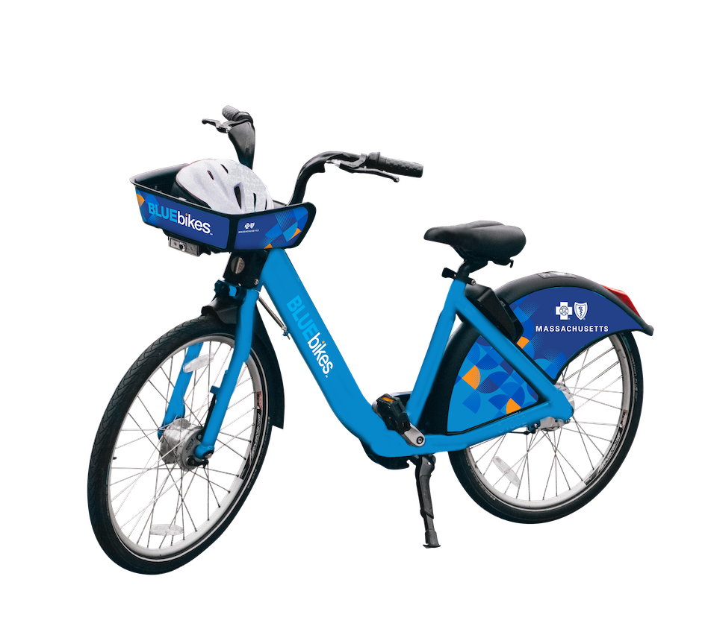
Summary
Research Goal: Describe Blue Bike usage patterns in Boston and understand how Blue Bikes interact with MBTA infrastructure
Key Findings:
Identified distinct patterns in ridership between members and casual users, as well as between the stations we classified as ‘close to’ and ‘far from’ MBTA stops
Identified a significant relationship between the Blue Bike system and MBTA infrastructure as well as the MBTA line/stop locations where this interaction is strongest
Validated the hypothesis that Blue Bike members frequently use the system for first/last mile transit connections
Highlighted key features of the most popular Blue Bike stations, providing valuable insights to inform bike planning efforts for 2025
Notes:
Daniel

Slide 28
Future Analyses
Additional Opportunities:
Incorporate MBTA Ridership Data
Explore the relationship between MBTA and Blue Bike usage
Impact of MBTA Closures:
Analyze how station/line closures affect Blue Bike usage
Assess Blue Bike and MBTA stop locations across neighborhoods, focusing on socioeconomic factors
Potential Insights:
Further our understanding of the relationship between the two systems
Support equitable transit planning and infrastructure development
Notes:
Justin

Slide 29
THANK YOU

